Slide 1
Online Insurance System
By
1.Sabbani Arun
2.Kancham Keerthi Reddy
3.Bathineni Venu Kumar
4.Harish S
5.Sandya

Slide 2
Contents
Abstract
Project Explanation
System Requirements
Web Pages

Slide 3
Abstract
The Online Insurance System is a digital platform designed to simplify purchasing, managing, and claiming insurance policies. It offers a variety of products, including health, life, automobile, and home insurance. Users can compare policies, obtain instant quotes, and choose the best coverage. Key features include secure user authentication, an intuitive dashboard for policy management, and streamlined claims processing with real-time tracking. The system supports seamless premium payments and sends automated renewal reminders. Advanced algorithms provide personalized policy recommendations. The platform ensures high security with advanced encryption. Overall, it enhances customer satisfaction and operational efficiency in the insurance industry.

Slide 4
Project Explanation
The Online Insurance System simplifies buying, managing, and claiming insurance policies online, making the process more user-friendly, efficient, and secure.
1. Product Range: Offers health, life, auto, and home insurance to meet various needs.
2. User-Friendly Interface: Easy-to-use dashboard for smooth navigation.
3. Policy Comparison and Quotes: Compare policies, get details, and instant quotes to make informed choices.
4. Secure User Authentication: Protects data with strong login and encryption.
5. Claims Processing: File and track claims online with real-time updates for quick settlements.
**Benefits**
1. For Users: Convenient and transparent management of insurance needs in one place with personalized recommendations.
2. For Insurers: Automates tasks, provides insights, and helps improve customer retention and risk management

Slide 5
System Requirements
Software requirements
Python: version 3.9
Web Framework : Django
Database : MySQL, SQLite.
Integrated Development Environment (IDE): Visual Studio Code, PyCharm.
Version Control: GitHub.
Hardware Requirements
Computer
Memory (RAM): At least 4GB of RAM
Storage
Network Connection

Slide 6
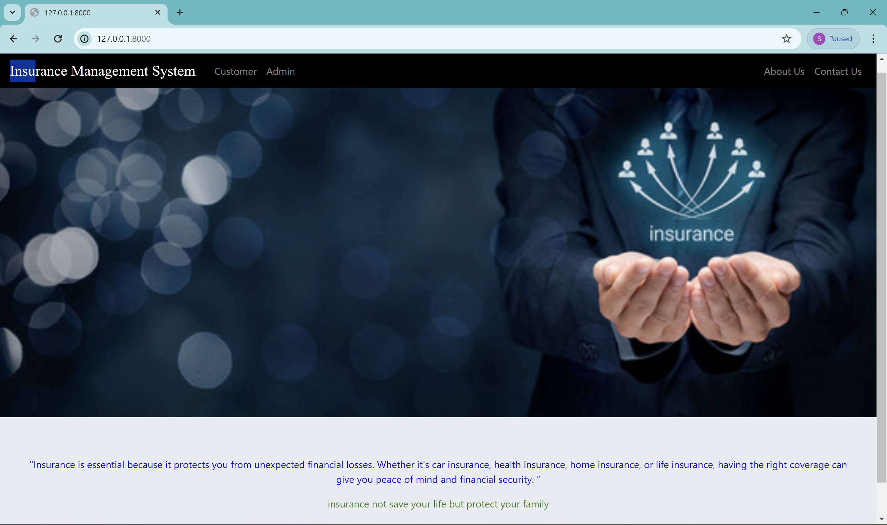
Home Page

Slide 7
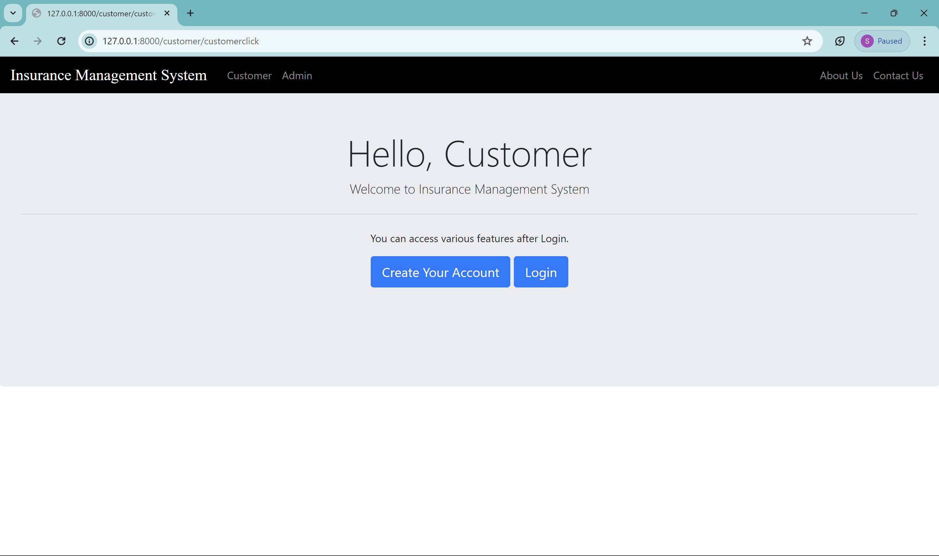
Customer

Slide 8
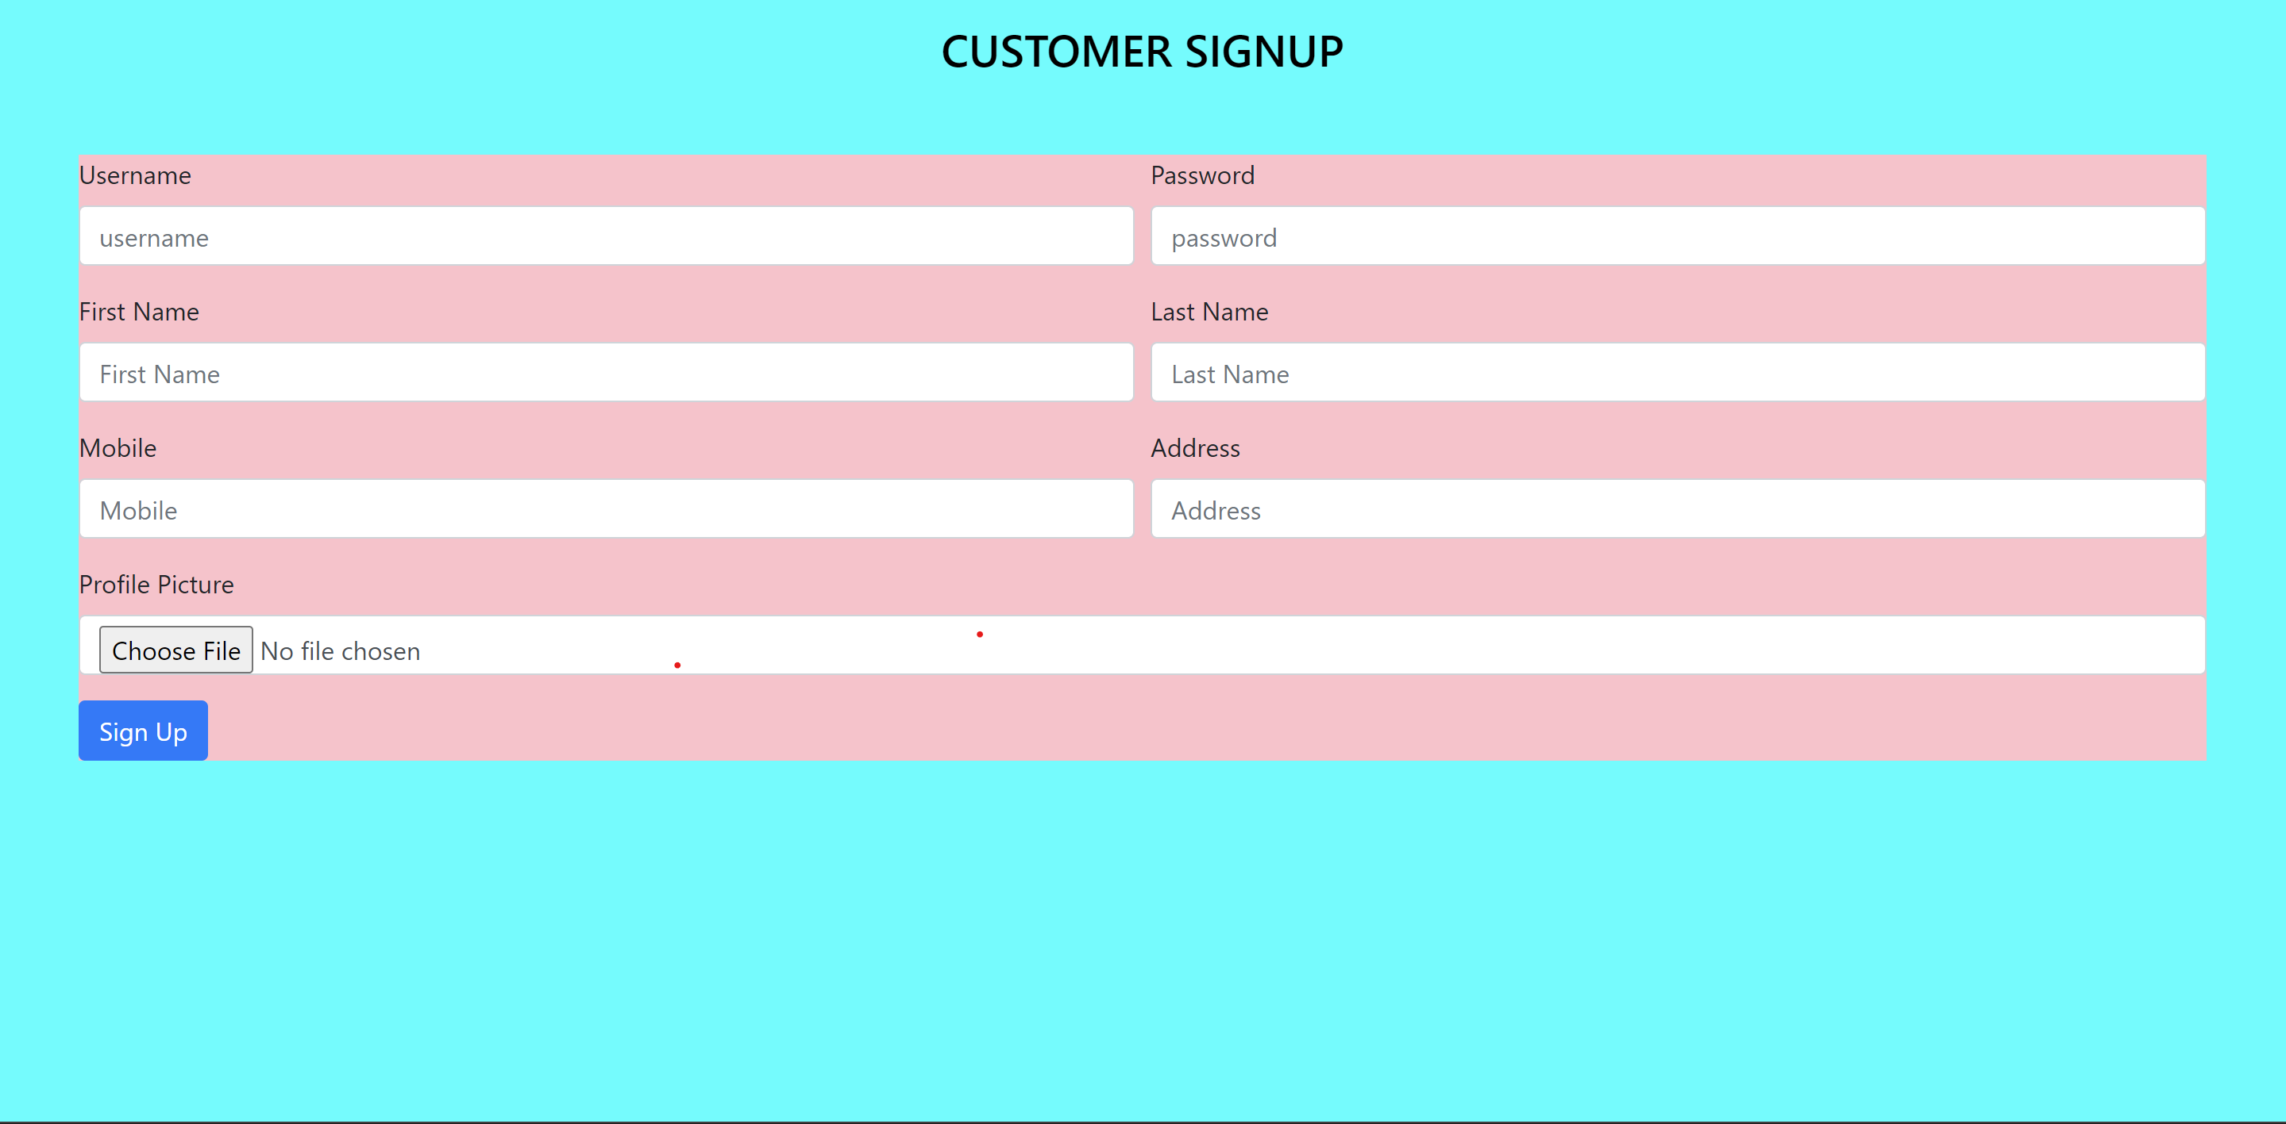
Customer Account Creation

Slide 9
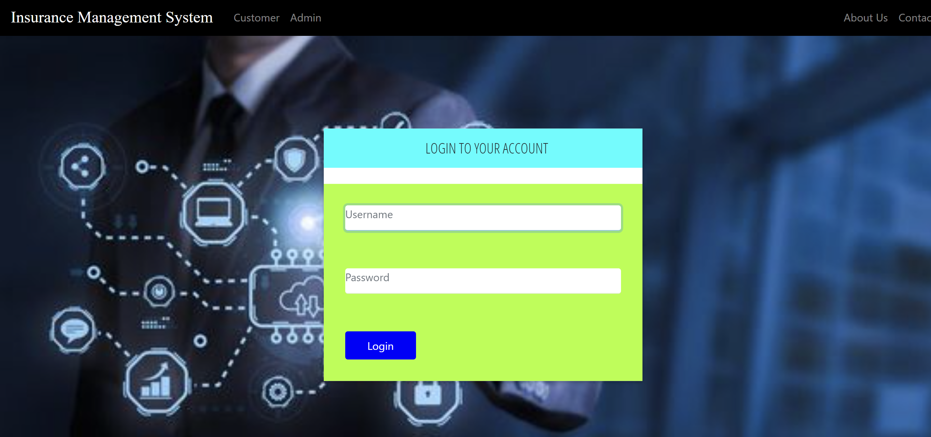
Customer Login

Slide 10
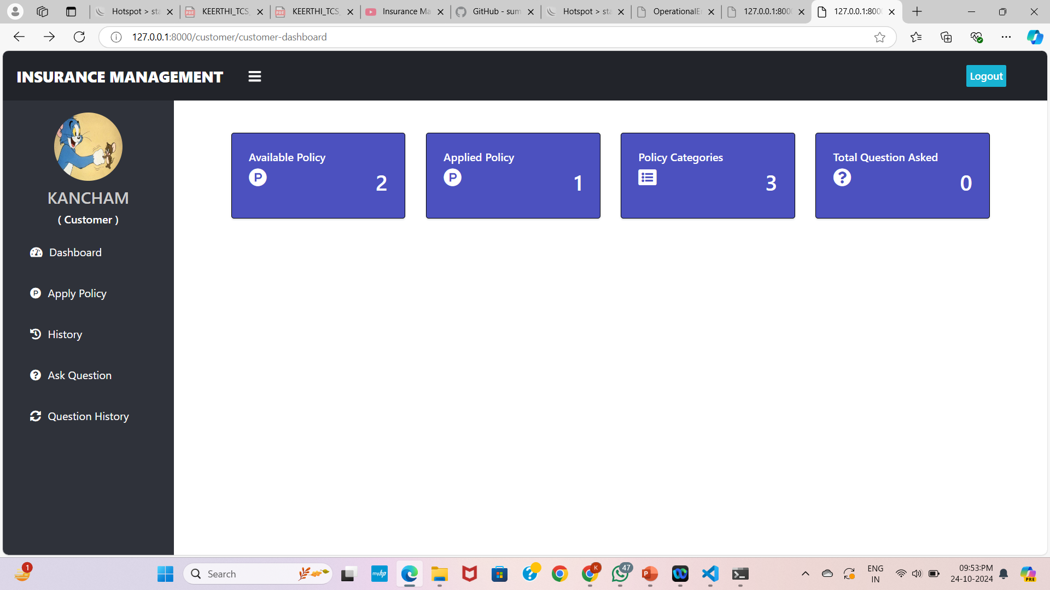
Dashboard

Slide 11
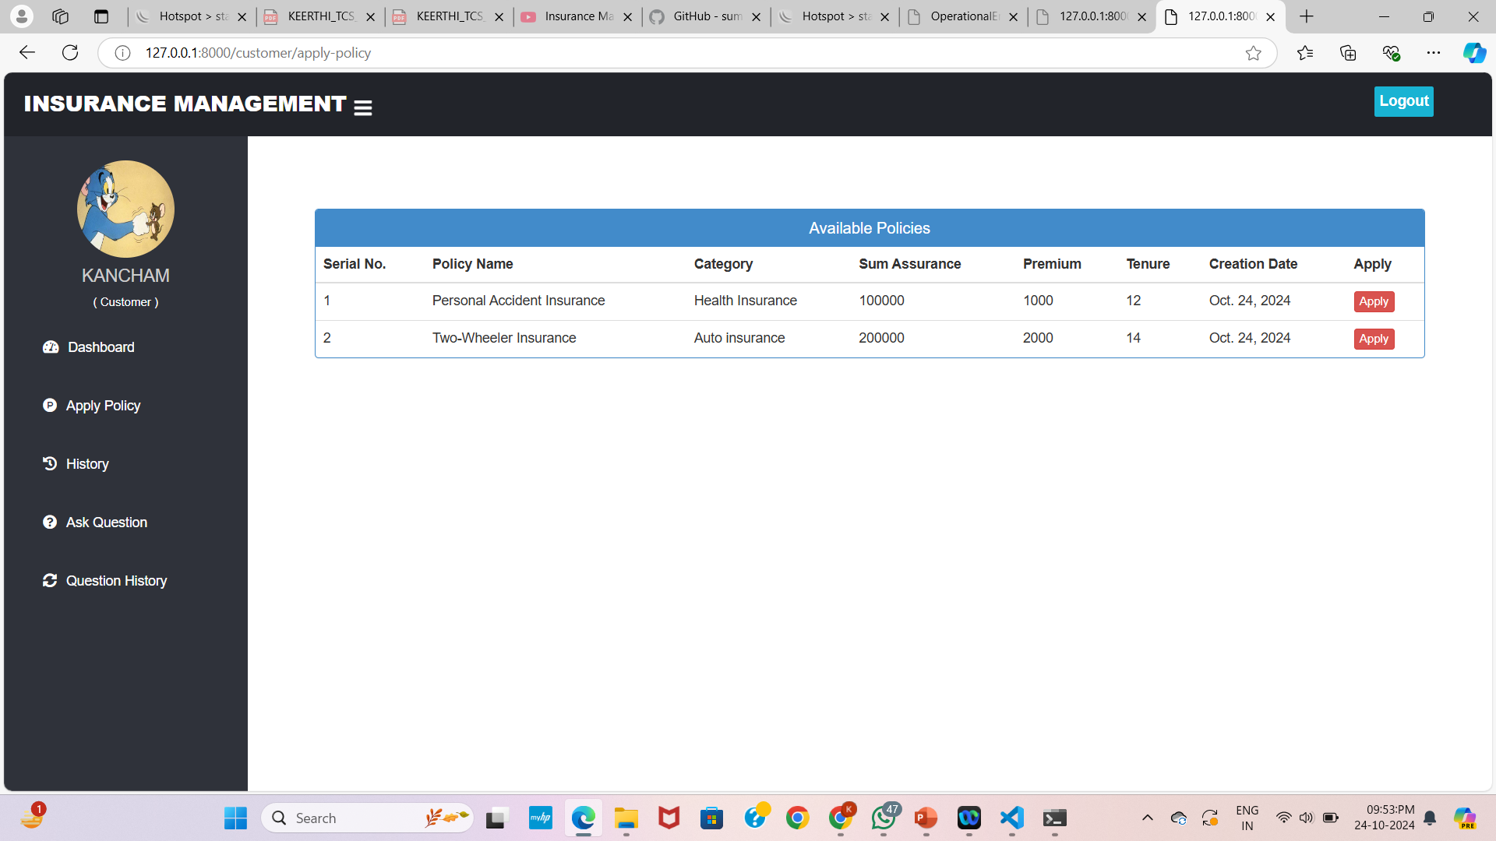
Policies

Slide 12
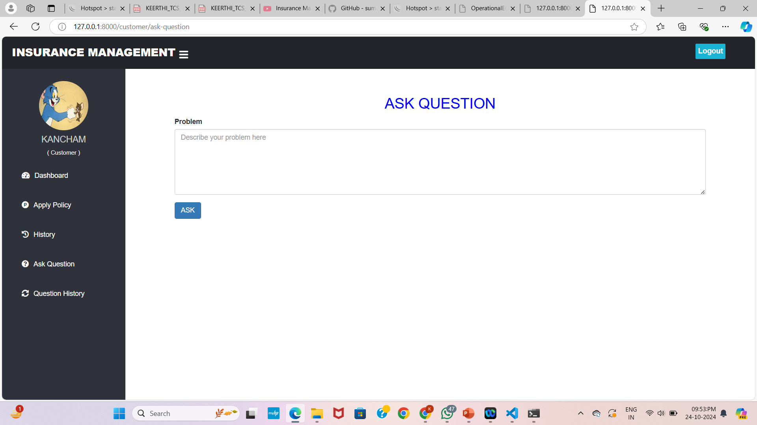
Customer ask doubts to admin

Slide 13
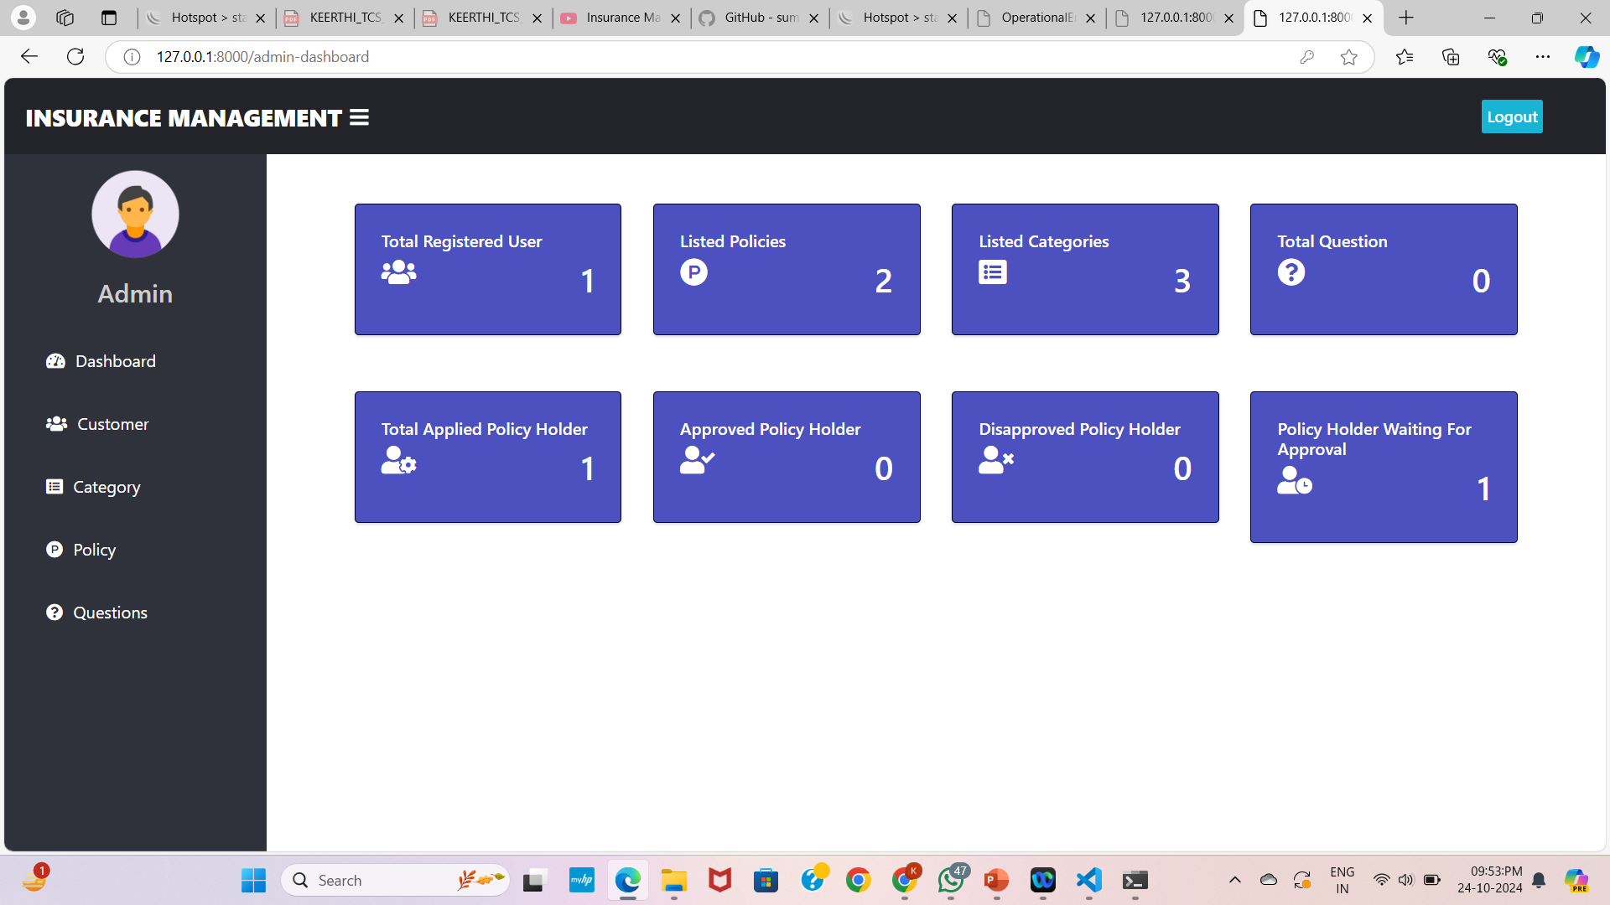
Admin Dashboard

Slide 14
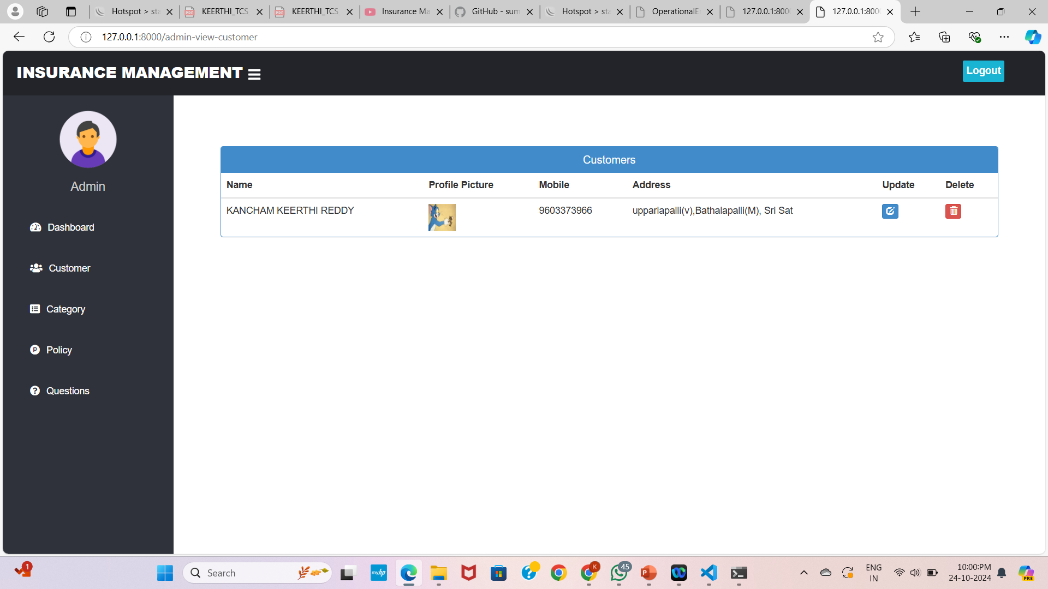
Customers

Slide 15
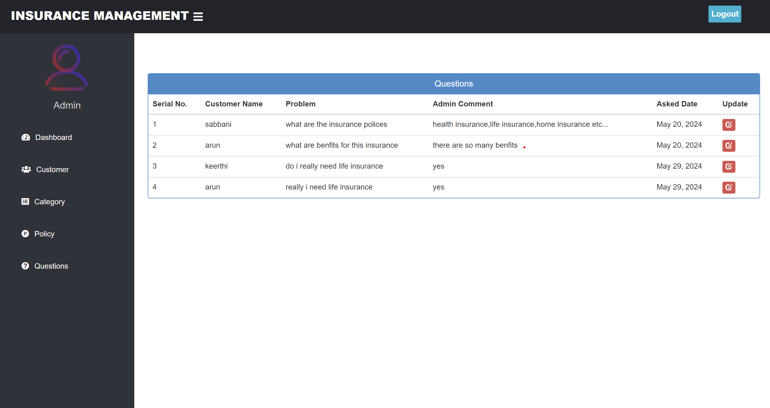
Admin Answer to Customer Questions

Slide 16
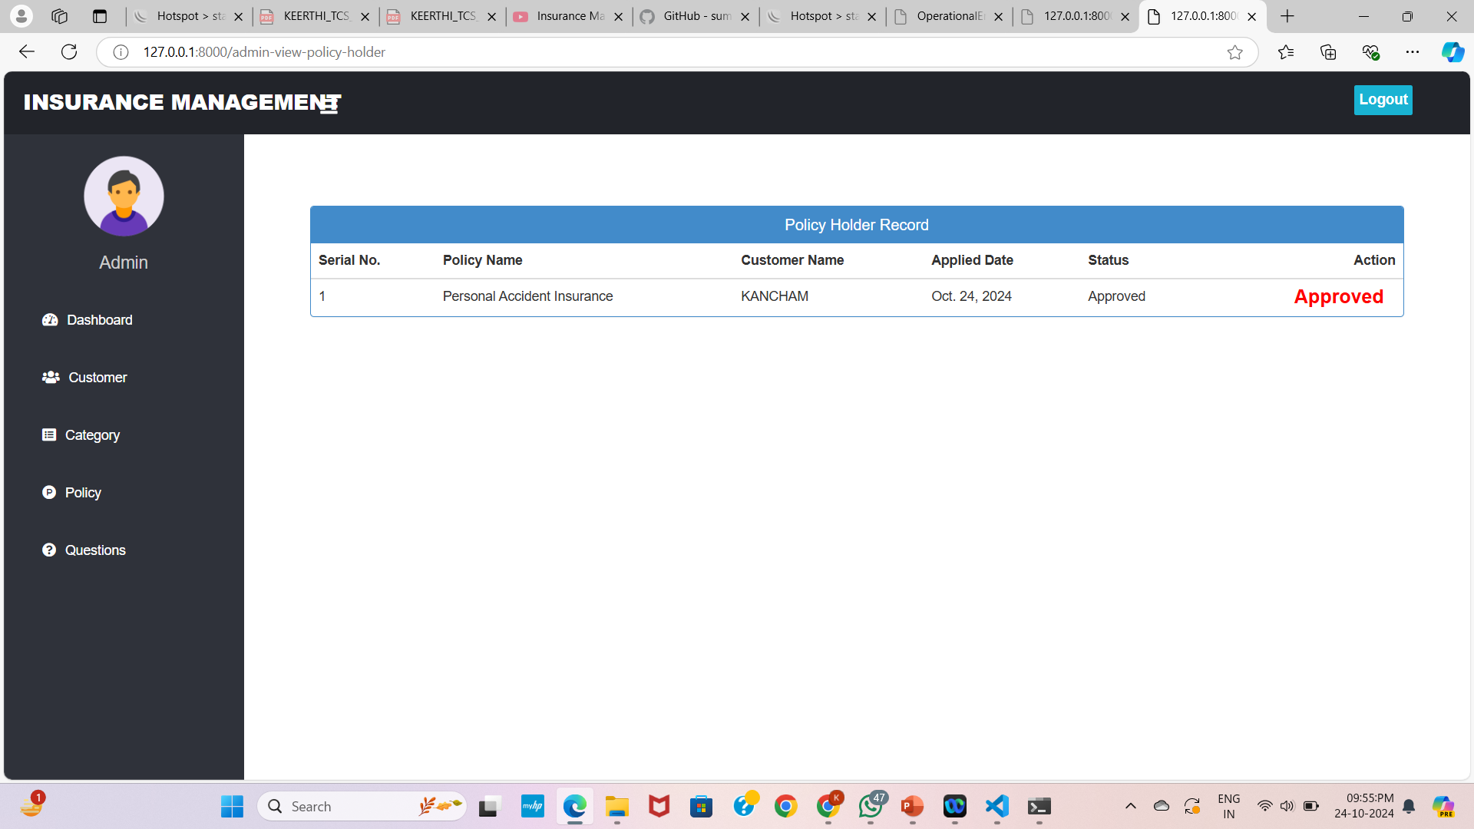
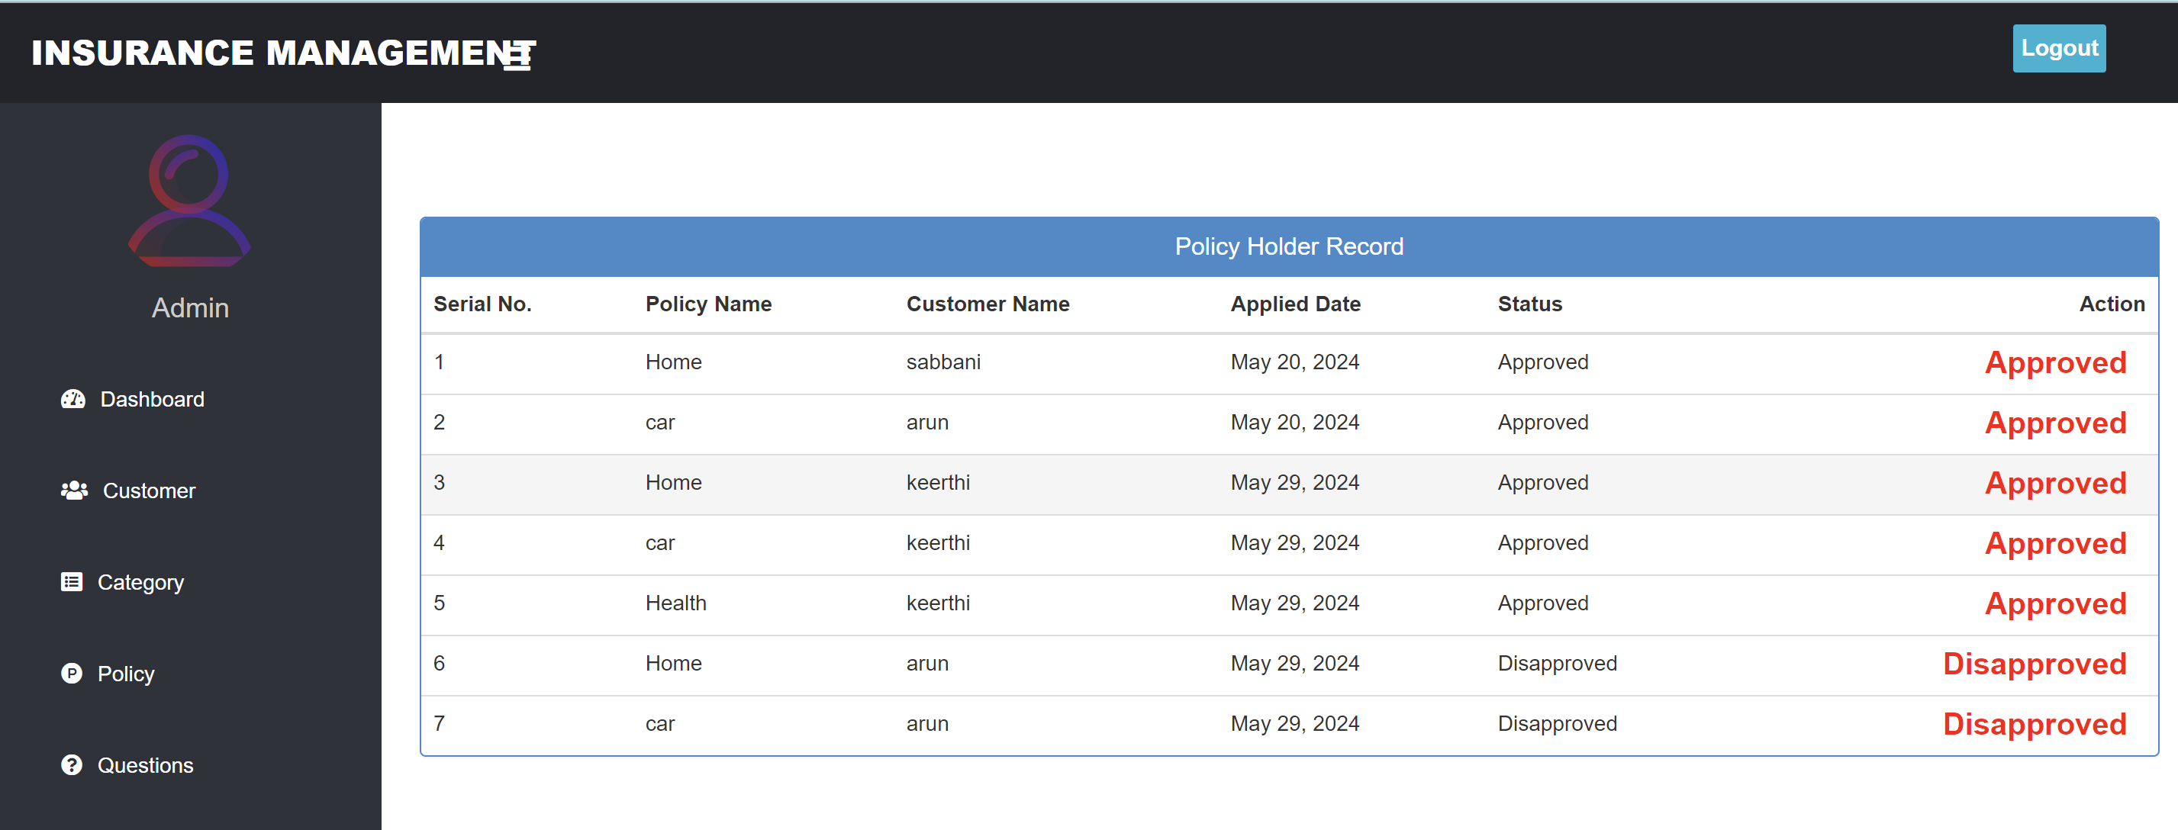
Applied Policy Holders

Slide 17
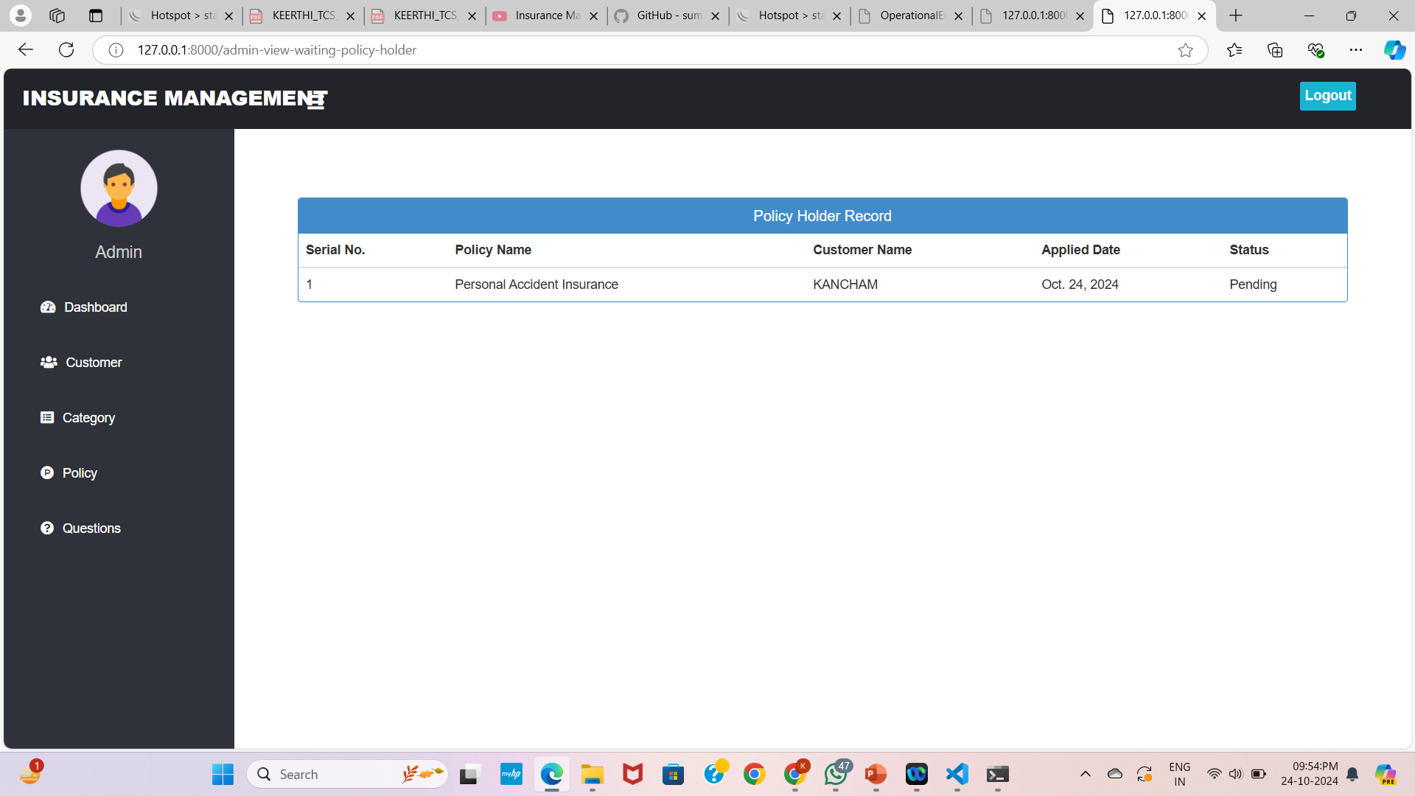
Policy Holder Status

Slide 18
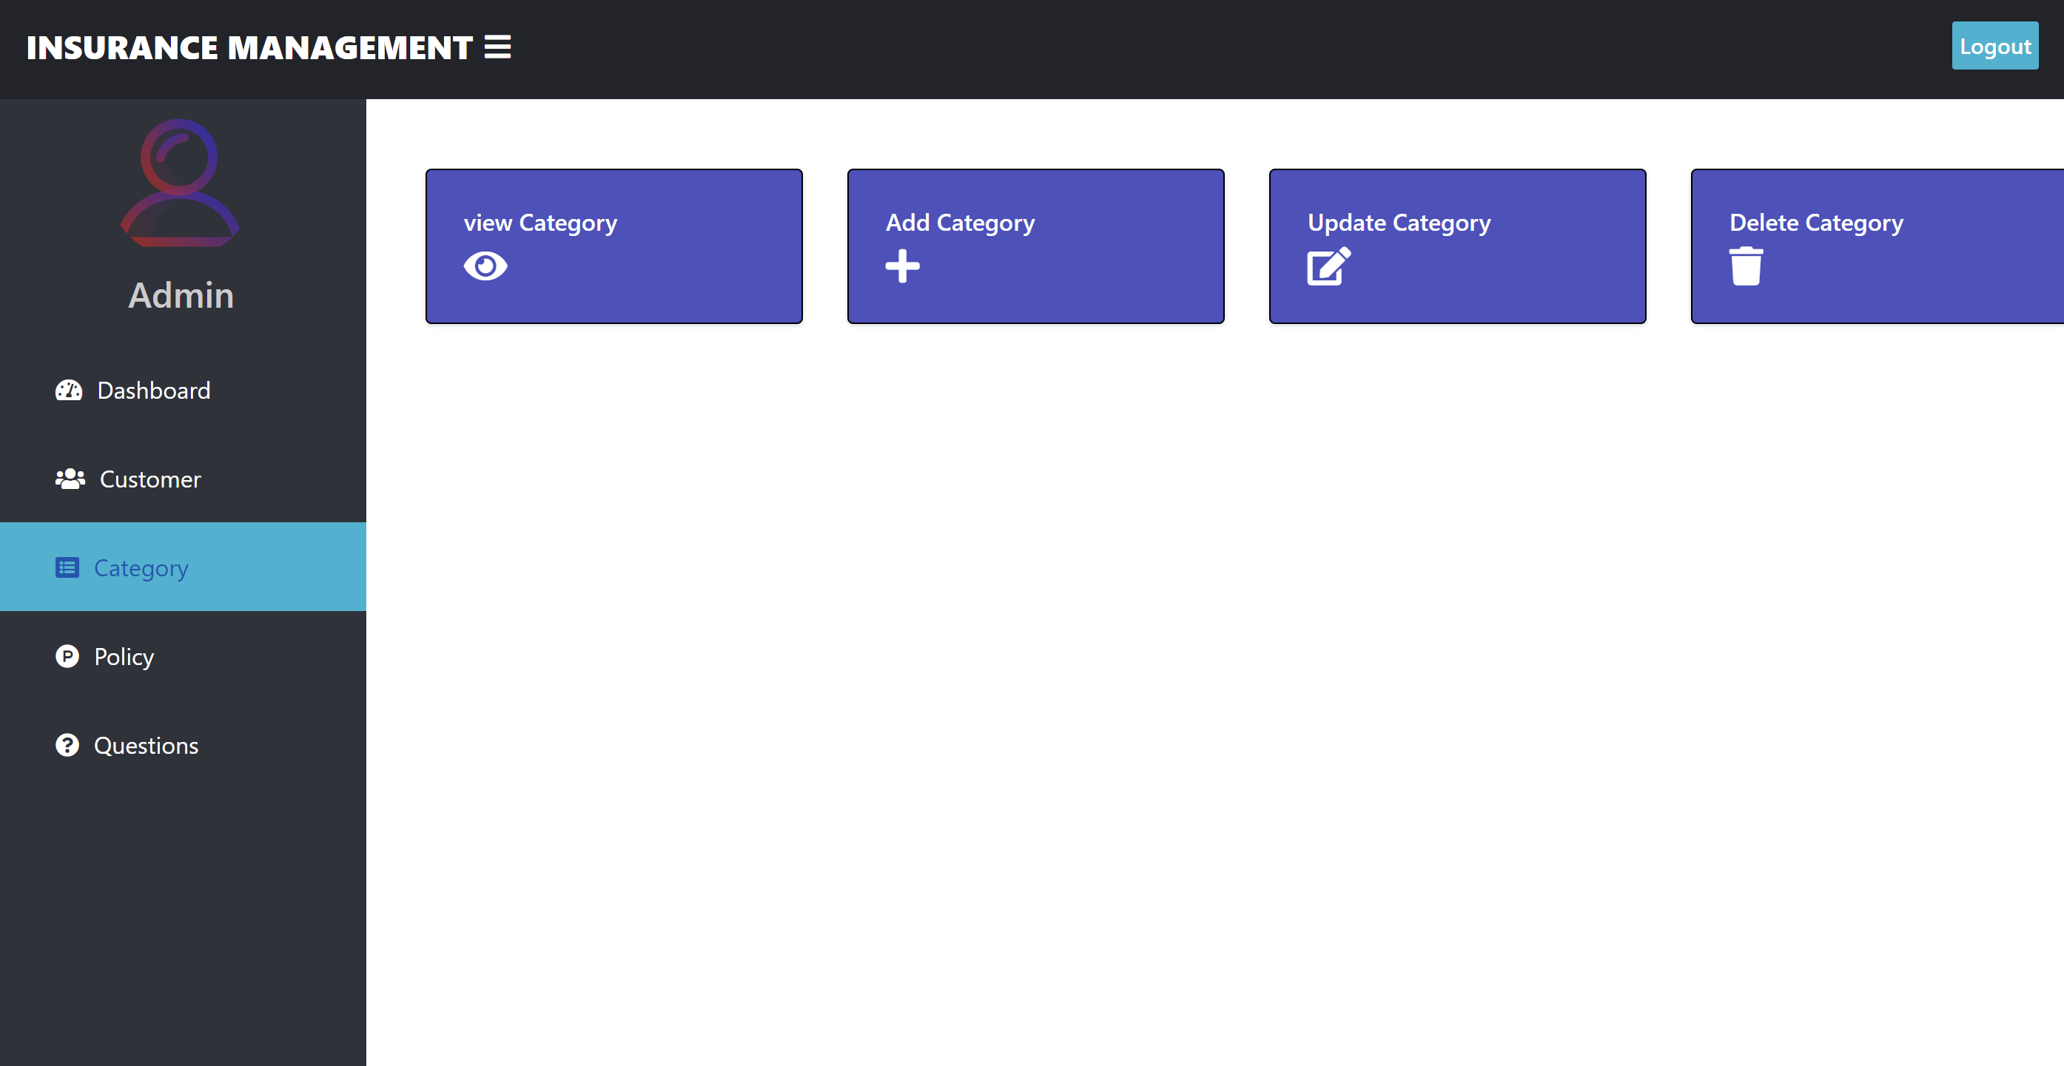
Category

Slide 19
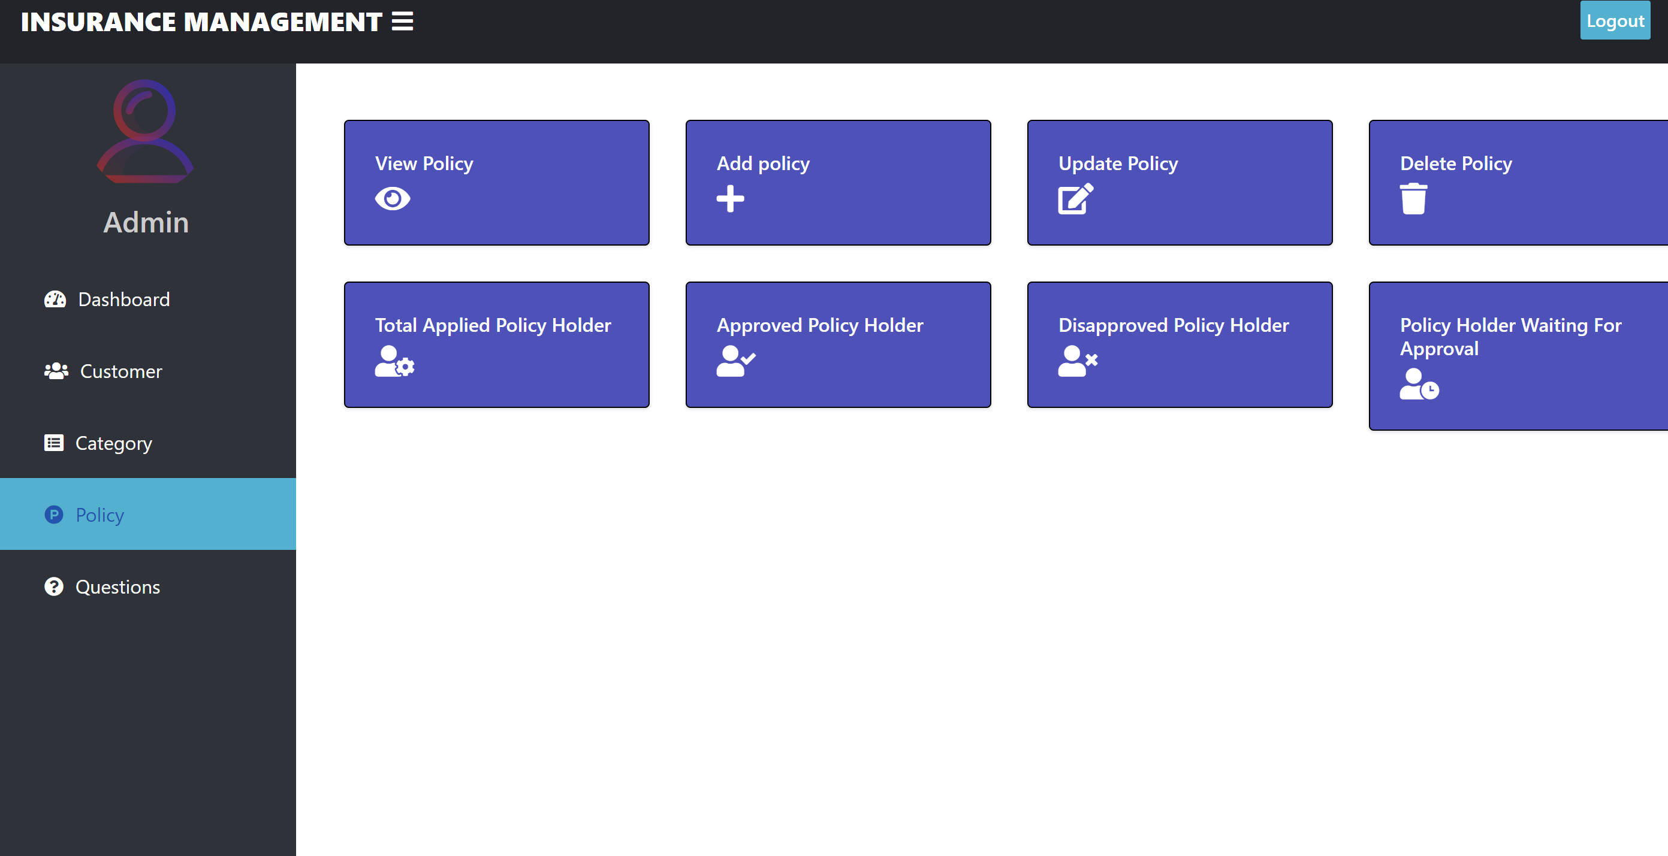
Policy Status

Slide 20
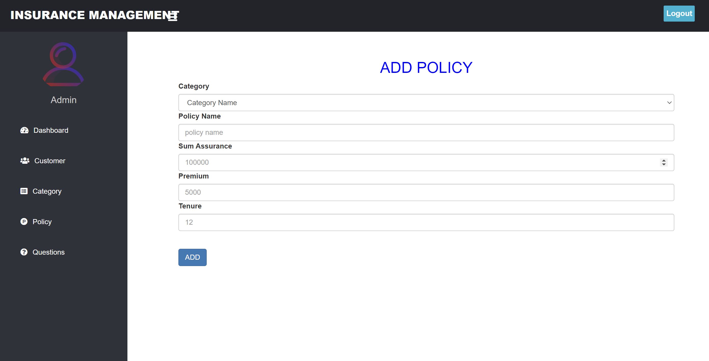
Policy Addition

Slide 21
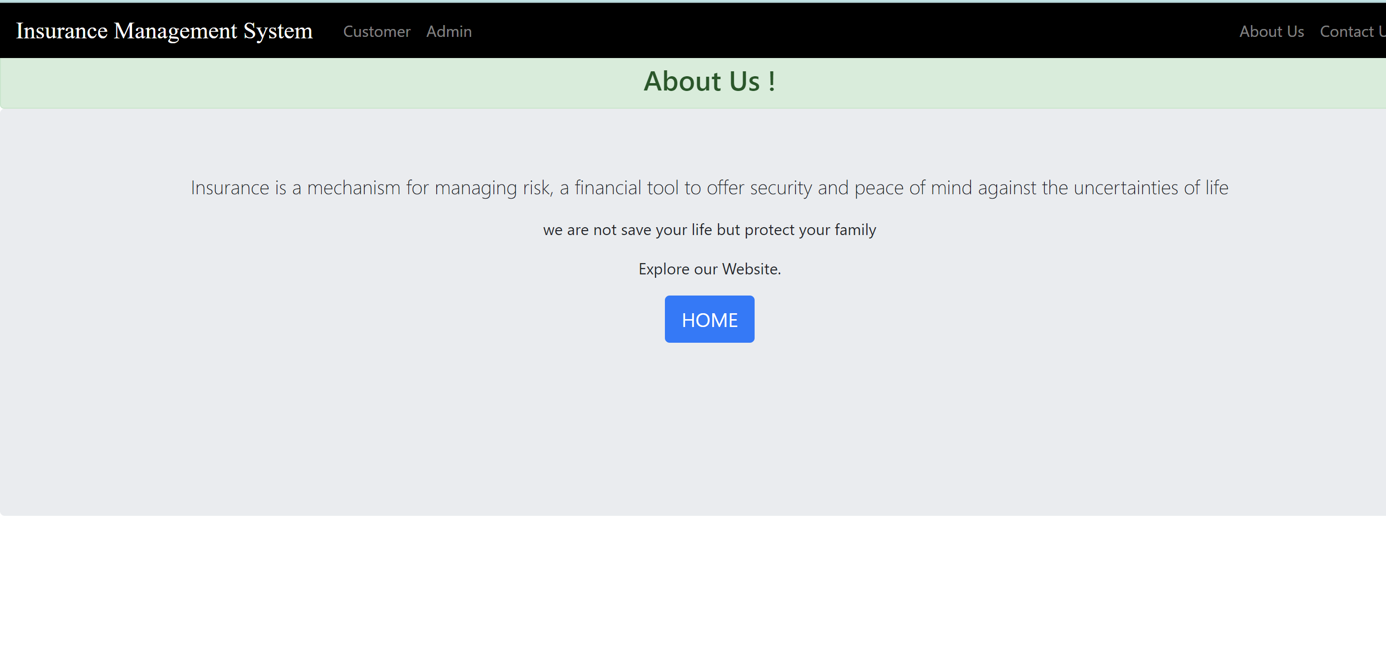
About Us page

Slide 22
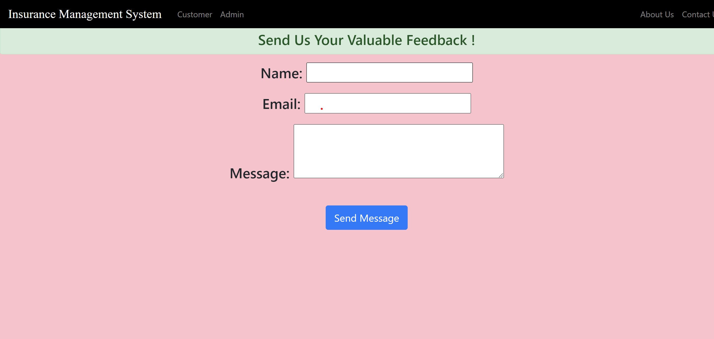
Feedback Submission

Slide 23
Conclusion
The Online Insurance System simplifies insurance processes, offering various products like health, life, auto, and home insurance. Users can easily compare policies, obtain quotes, and manage everything through a user-friendly dashboard. It ensures secure authentication and streamlined claims processing with real-time tracking, along with seamless premium payments and automated renewal reminders. Advanced algorithms provide personalized policy recommendations. For insurers, the system offers insights into customer behavior and policy performance, aiding decision-making. With advanced encryption, user data remains secure. In essence, the Online Insurance System enhances efficiency, security, and customer satisfaction in the digital insurance landscape.

Slide 24
Thank You

